Slide 1

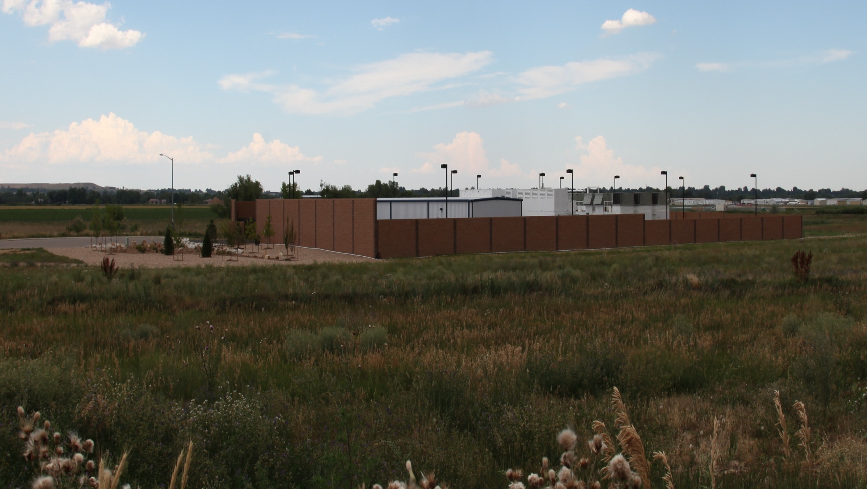

Bing Maps Private Cloud
Parallel Processing on the Prairie
31-Jul-2013

Slide 2
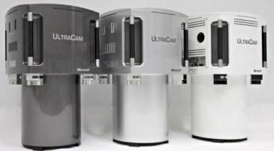
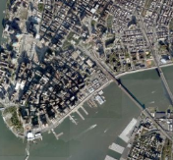
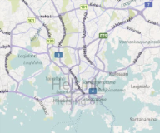
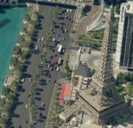
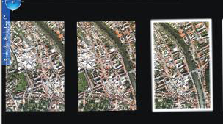
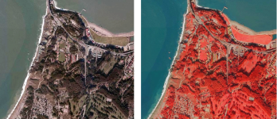
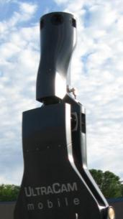
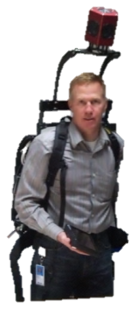
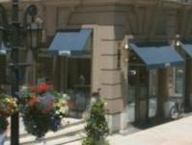
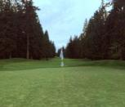
BITs Product Summary
Global Ortho
AERIAL
Oblique
Graz, Austria
UltraCam development
Commercial software
Computer vision research
UltraCam Aerial
Vectors
UltraMap
Boulder, Colorado
Bing Maps data center
Software development
Acquisition management
UltraCamM
UltraCamP
Streetside
TERRESTRIAL
Steve Stanzel, IPE GeoSpatial Program Manager

Slide 3
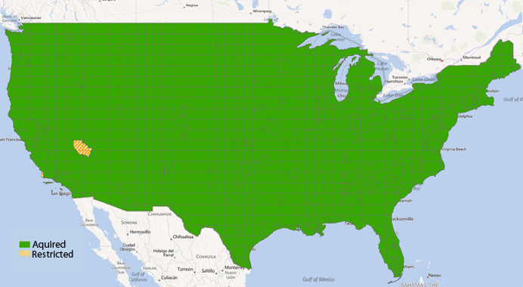
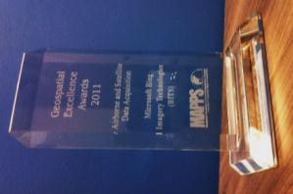
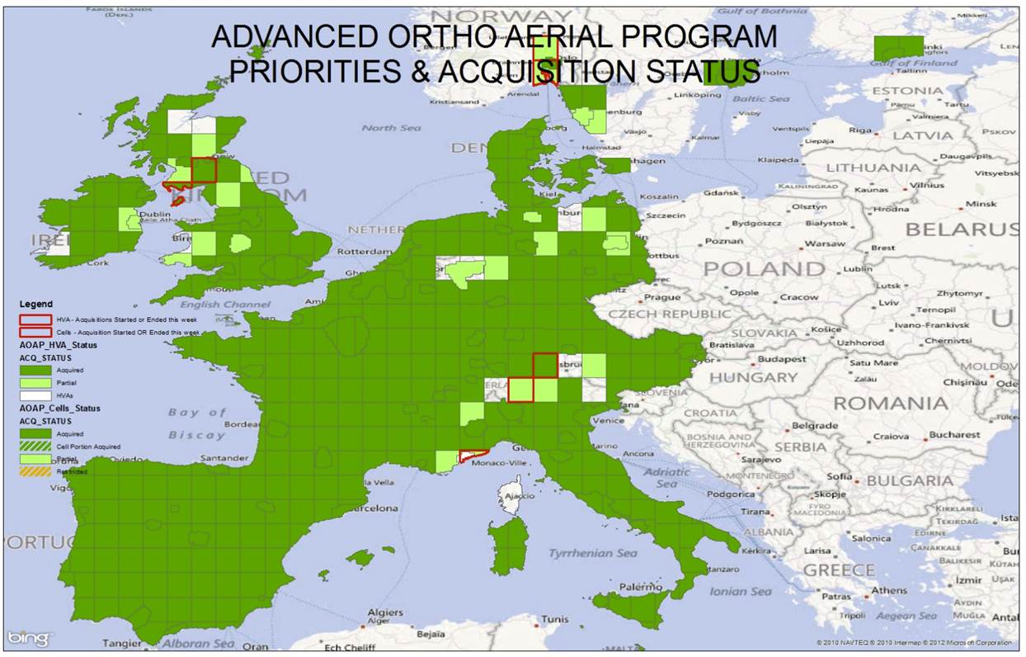
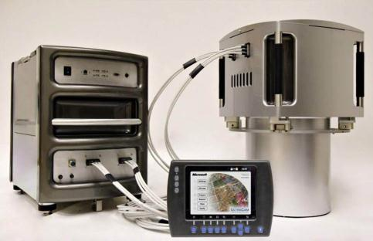
Global Ortho
Largest Aerial Mapping Project in Industry History
Complete Coverage US (“Lower 48”)
12 European Markets
10,400,000 square km
Order of Magnitude Cost Reductions:
USGS Program → 10 years; 50cm
Bing Program → 2.5 years; 30cm
24 months initial acquisition
238 terapixels, ~1.2 petabytes
UltraCamG (Giant)
Largest format aerial mapping camera
8 lenses, 14 CCDs, 28 HDDs
Pan, color, IR
28K pixel swath, 252M pixels total
417 MB / capture event
2.3 million collected to date
Ortho, Elevation, Classification
Exclusive to Clear 30 project
Notes:
Caveats on numbers

Slide 4
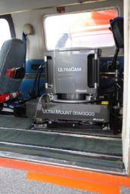
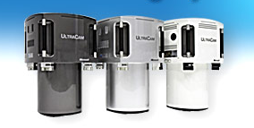
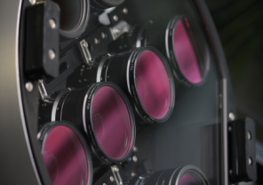
UltraCam Tech
UltraCam Xp (Large Format)
Simultaneously collects Pan, R,G,B, near infrared (NIR)
Panchromatic image size 17,310 x 11,310 pixels
Color and NIR image size 5,770 x 3,770 pixels
14 6μm CCD’s and 8 precision lenses
14 embedded computers managing 3 Gbits of throughput to 14 redundant drives
Approximately 6,600 uncompressed images per data storage unit (~4.2 TB)
11 hours of collection time per single data unit at typical speeds and flight lines
Image geometric accuracy is approximately +/- 0.002mm
Mobile Server, high capacity storage on the ground

Slide 5
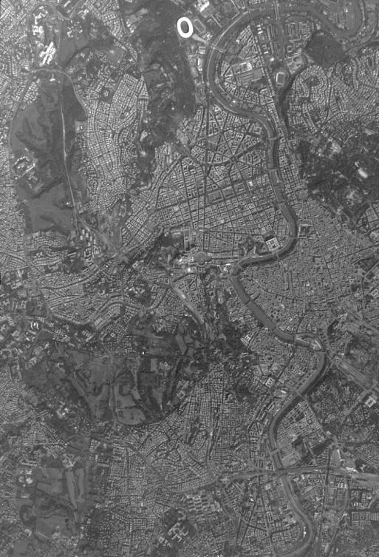
UCG Custom Aerial Camera for Global Ortho
Largest footprint of all camera systems
~9 km
~6 km

Slide 6
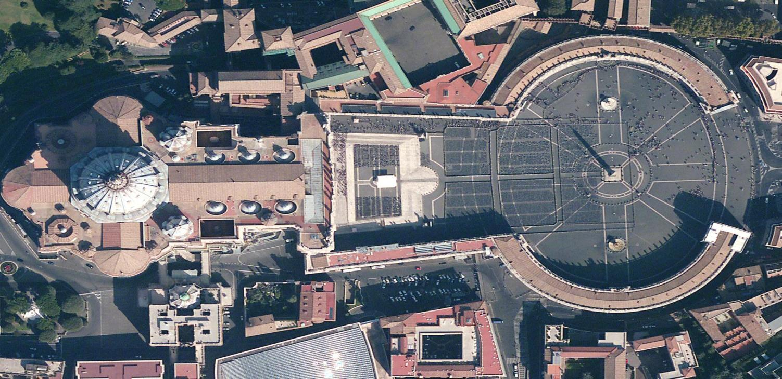
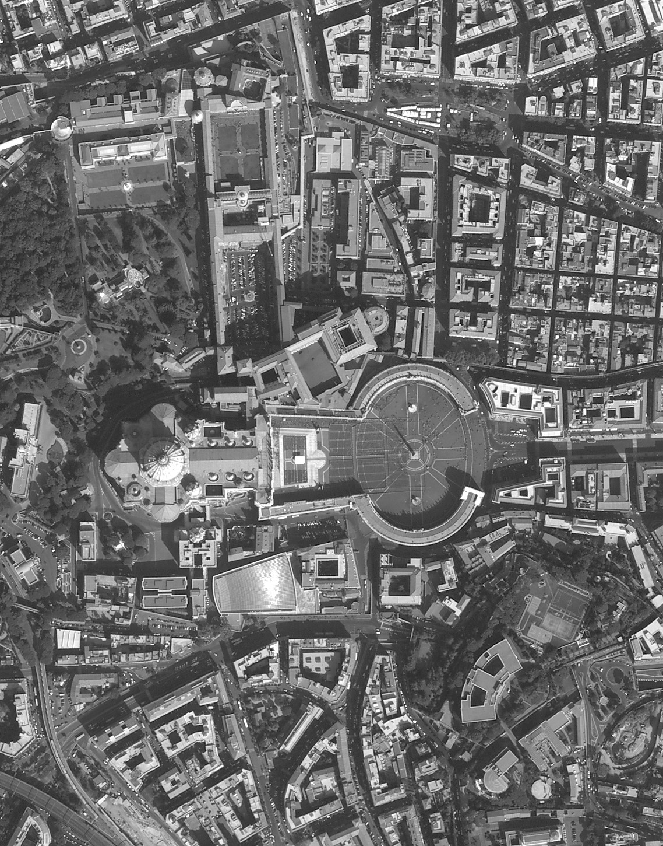
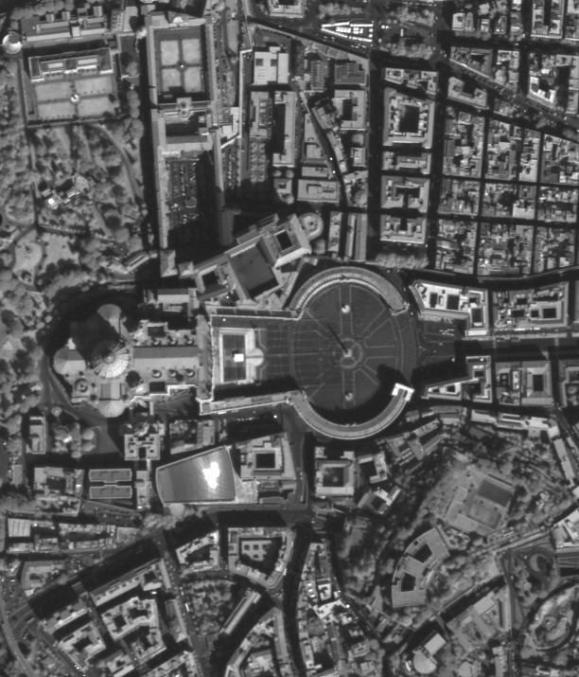
UCG image @ full resolution (Vatican City)
Grayscale
Infrared

Slide 7
Global Ortho Processing
Data Collection
Aerial Triangulation
Radiometry Processing
Build Cameras
Partner with Fliers
1PB imagery
UMAT
Ground Control
Haze Removal
Sun Hotspot Removal
Tone Balancing
Ortho Rectification
Mosaicing
Export
Re-project Images
Define Seam Lines
Apply Seam Lines
Apply Color Corrections
Seam Line Blending
Re-project To Output Formats
Copy to EHDs and ship

Slide 8
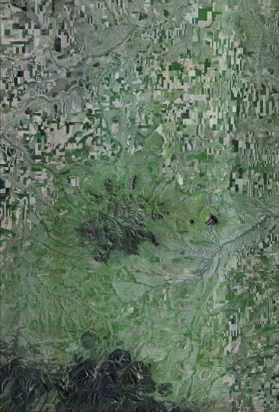

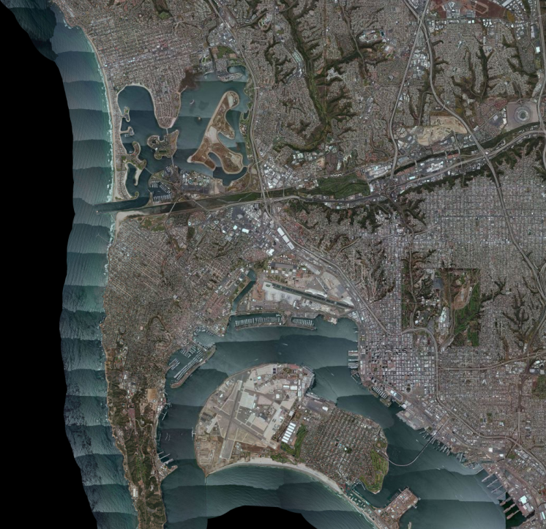
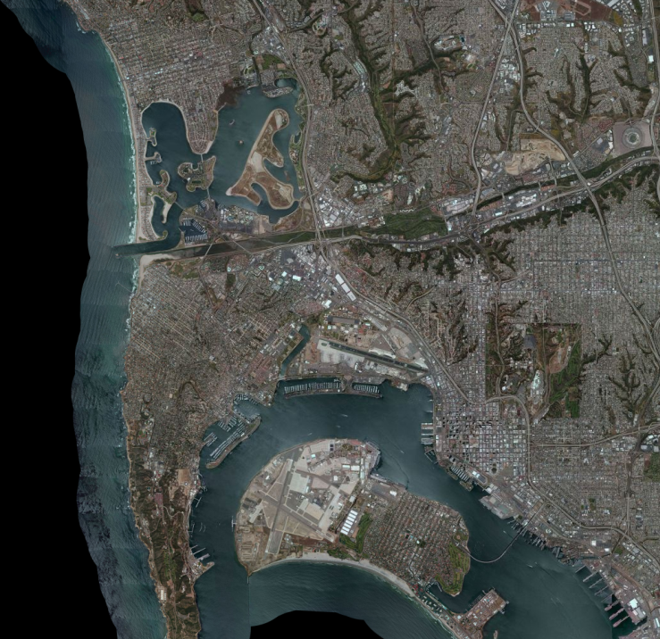
Radiometry Examples

Slide 9
Other things we do:
DSM, DTM, Classification
Bird’s Eye & Synthview
Streetside
Notes:
“Cowhide” – extraction of additional value or revenue from imagery assets.

Slide 10
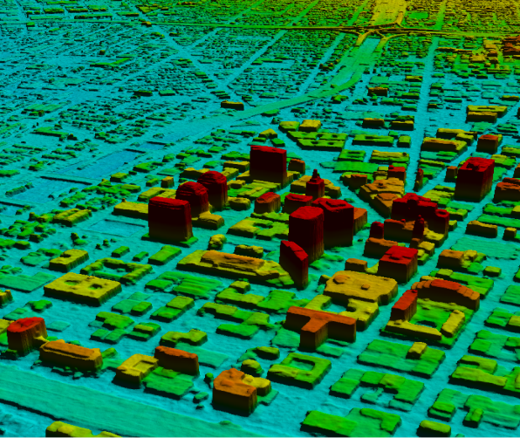
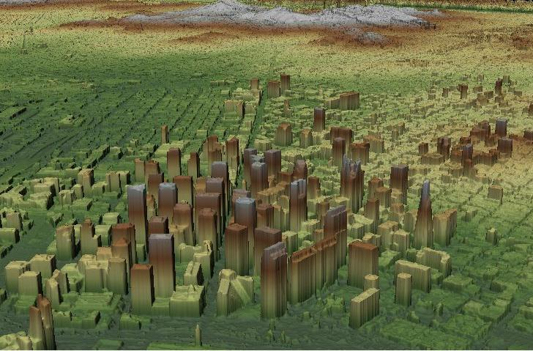
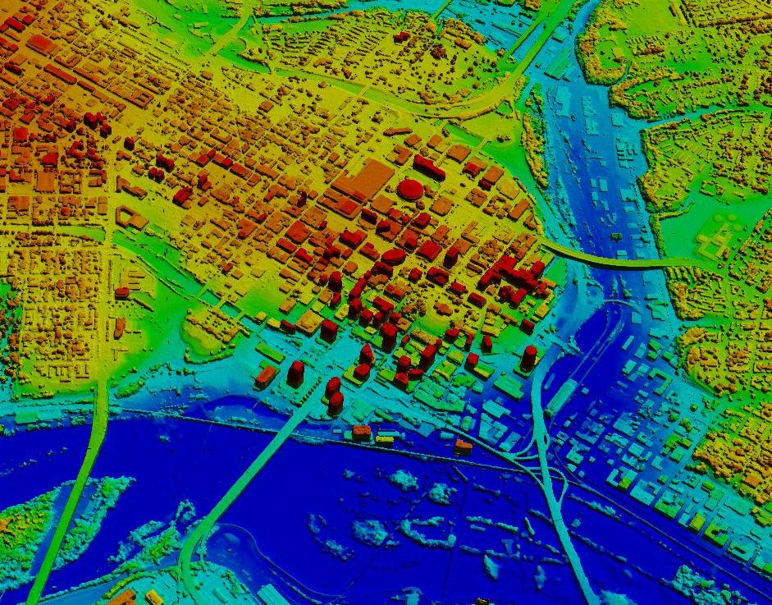
We match pan images to get DSMs
Oakland
San Francisco
Richmond, VA
Notes:
Stereomatcher run on multiple stereo-pairs and results are fused together

Slide 11
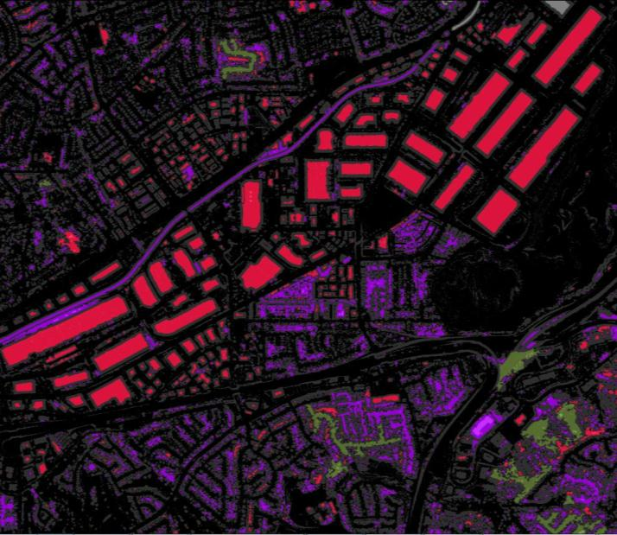
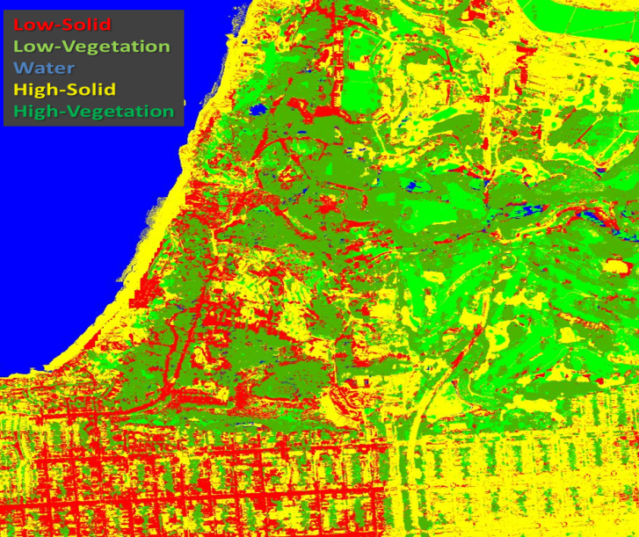
We classify buildings, craters, vegetation, water, …
Notes:
Left image shows high-slope areas in grey, red/pink shows building centers, other colors = ground-level
Right image shows classification results from PCVLib

Slide 12
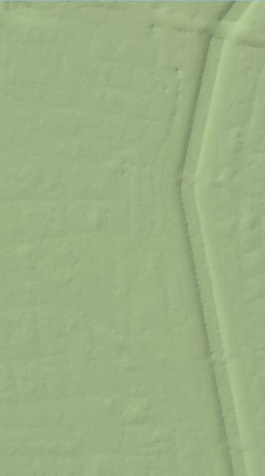
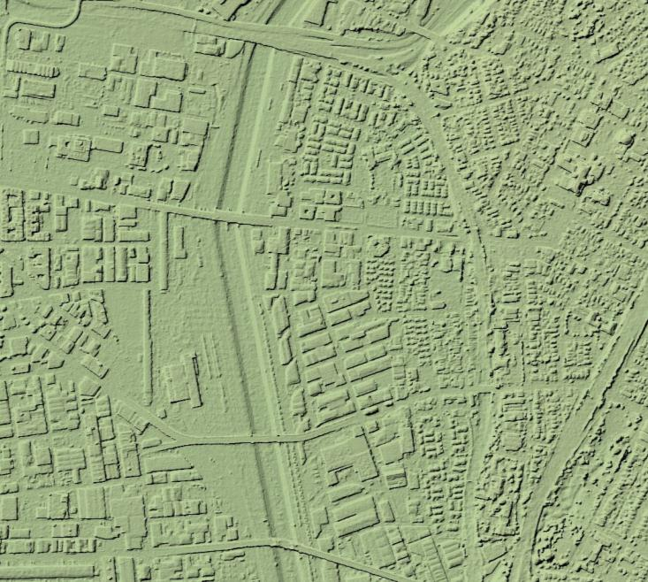
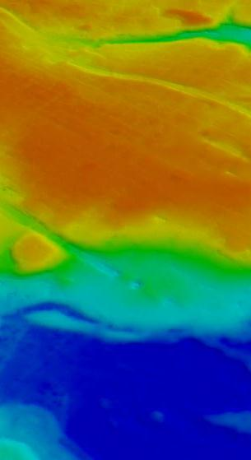
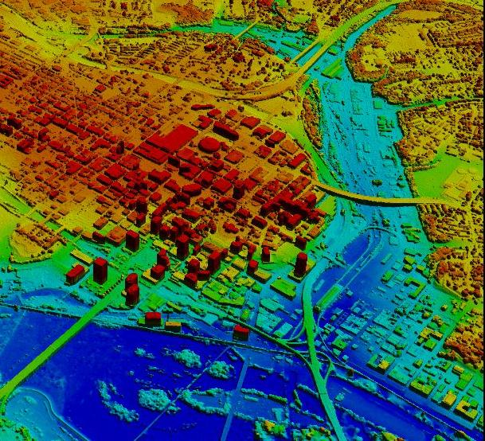
Using DSM and classification, we extract a DTM
Los Angeles, CA
Richmond, VA
Notes:
Ortho DTM is then used to ortho-rectify imagery for delivery to DG

Slide 13
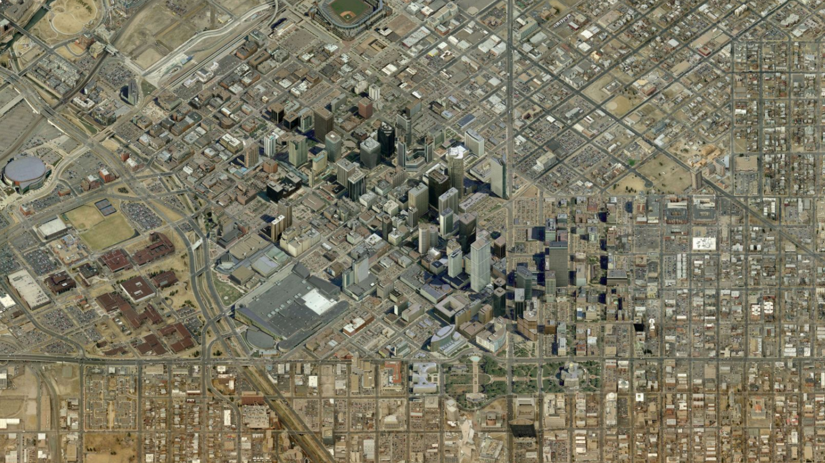
Bird’s Eye / Oblique Imagery

Slide 14
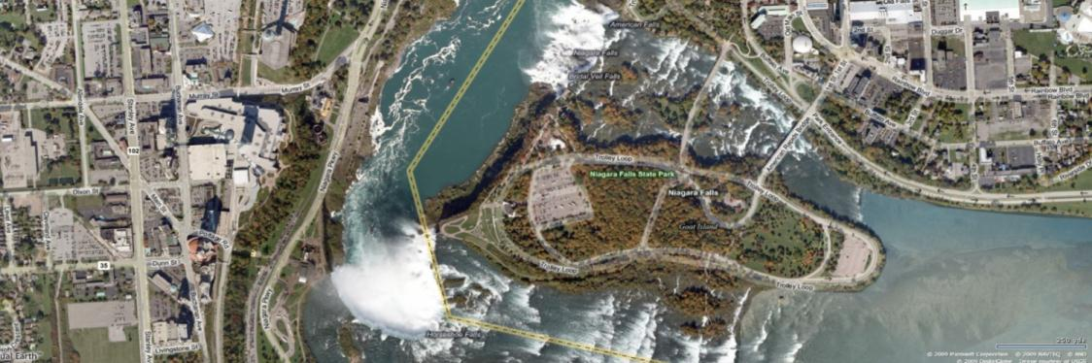
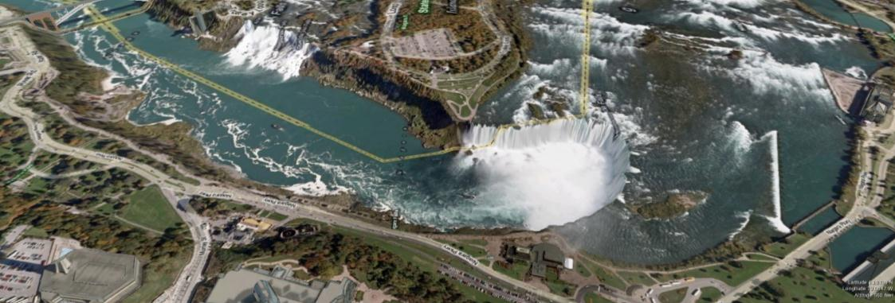
Re-projected Ortho
N
N

Slide 15
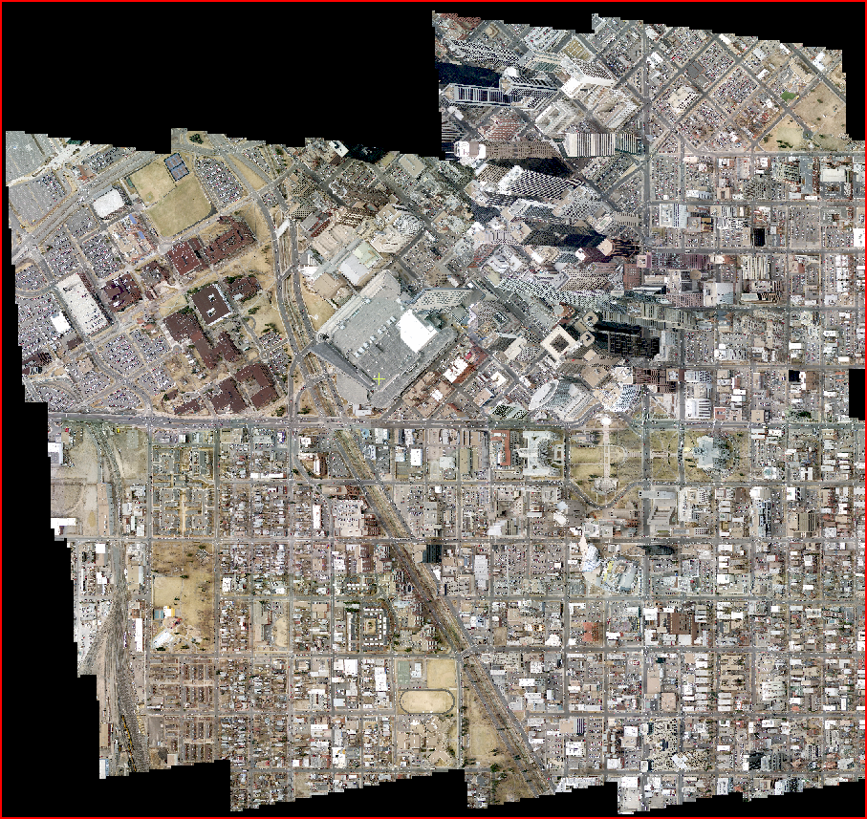
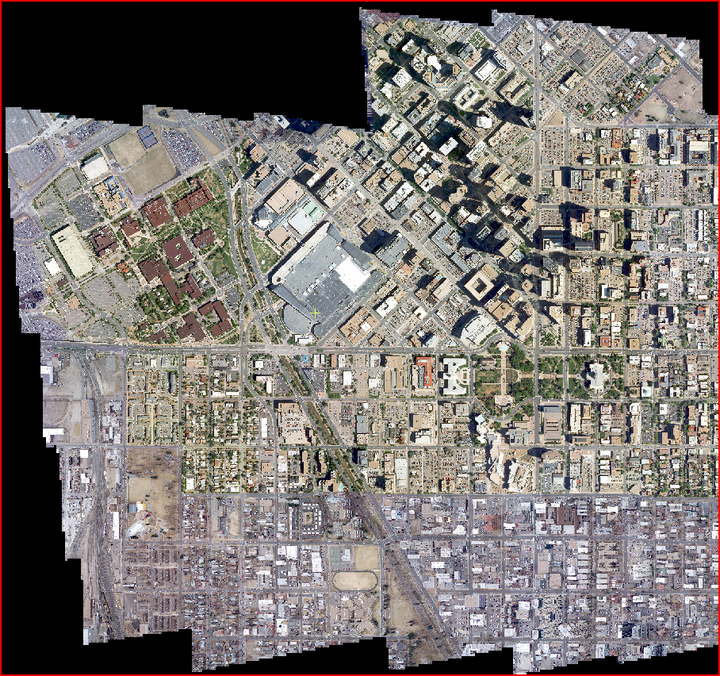
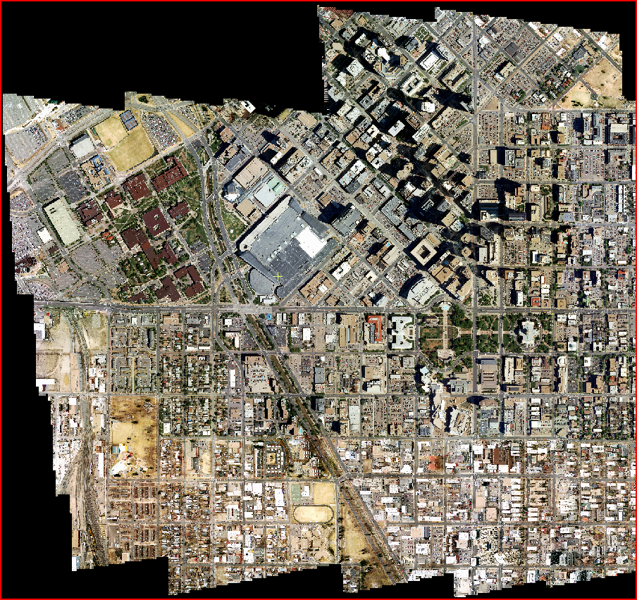
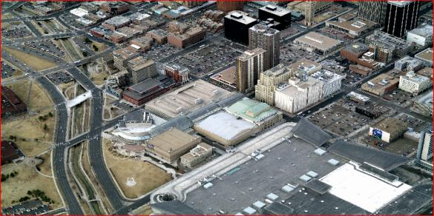
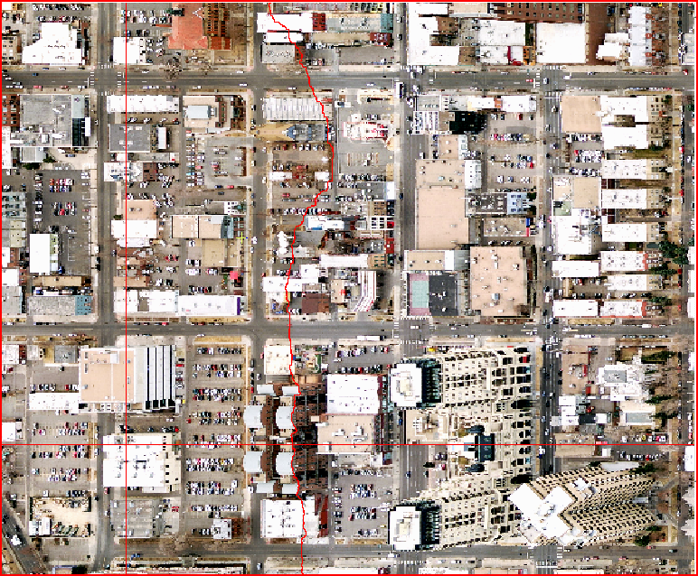
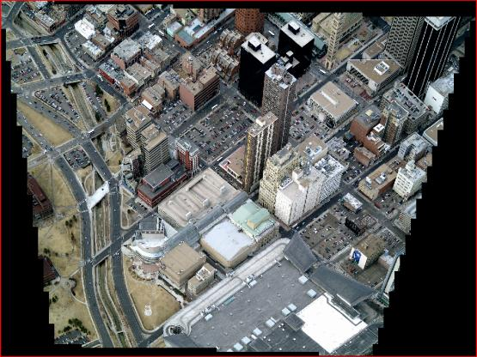
SynthView Processing Steps
15
1. Orthorectification
2. Seam line detection
3. Ortho inset
4. Color balancing
5. 3D models

Slide 16
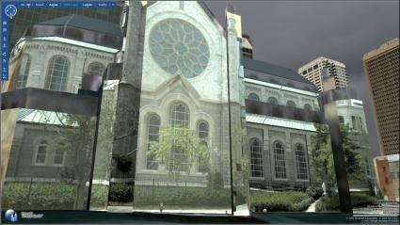
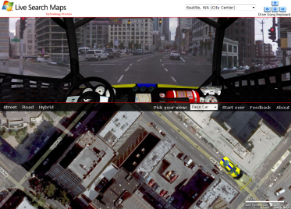
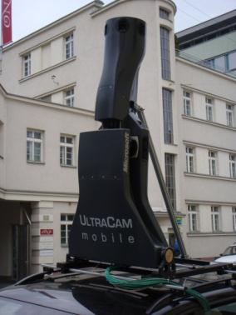
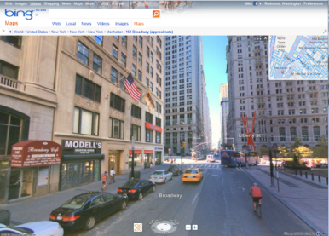
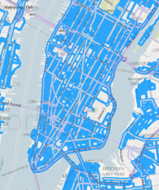
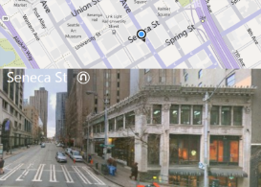
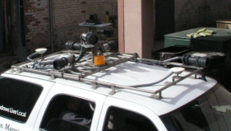



Streetside
5th 6th generation sensor 54 mp/capture event
Panoramic camera, LIDAR, GPS, IMU, DMI
4th generation user experience
Silverlight-based “cube” viewer
Simplified geometry

Slide 17











9 Distinct Data Products
5. Low-rez thumbnail
6. Tiled vector data for overlays
7. Event-to-vector mapping
8. Coverage overlays
1. Panoramic imagery
2. Raster depth map
9. Geopositioning metadata
3. Simplified geometry
4. Privacy masks

Slide 18
Image Processing Framework
Our “Map/Reduce” framework that parallelizes our image processing algorithms across our 23k cores and 72 petabytes of storage

Slide 19
Big Data
Software as a Service (SaaS)
Examples of SaaS include: Google Apps, Quickbooks Online and Salesforce.com
Platform as a Service (PaaS)
Examples of PaaS include: Amazon Elastic Beanstalk, Heroku, EngineYard, Google App Engine, and Microsoft Azure
Infrastructure as a Service (IaaS)
Examples of IaaS include: Amazon CloudFormation (and underlying services such as EC2), Rackspace Cloud, Google Compute Engine, and RightScale
Image Processing Framework
BIT Compute
Our “Map/Reduce” framework that parallelizes our image processing algorithms across our 23k cores and 72 petabytes of storage

Slide 20


The Big Picture
MS
GFS
Data
Center
Flyers &
Data
Capture
Vendors
Ingest
Image
Processing
Framework
Publish
Image
Publishing
System
Update
Drop
Specs
Files
Stitch
Files
Meta
Data
Imagery

Slide 21
What is the IPF?
Parallel Processing Framework and GeoSpatial metadata store
Manages up to “N” 2000-ish multi-core node “Clusters” cooperating to produce an answer
Multi-Petabyte redundant (3 copies) storage system
Standard Windows/.NET APIs to read/write data files
Data files can be versioned and have commit/rollback semantics
Meta-data repository of geo-spatial data
Supports automatic (headless) and manual (interactive) processing
Can execute scripts (powershell, .bat, etc), console apps, and GUI apps (manual only)
Implements “Data flow parallelism” through the disk system, i.e. no MPI support
Degree of parallelism and parallel data flow is 100% programmable
Data warehouse of coverage and tile usage
Comparable Systems:
Google’s Map/Reduce
Yahoo’s Hadoop
Windows High Performance Cluster
OSD’s Cosmos
Investment:
37 person-year investment, begun in 2006
100% C#/.NET implementation
Current team of 1 Lead, 3 Devs

Slide 22
IPF Processing Concepts
Pipeline – the logical graph of parallel operations
Process – a suite of separate parallel operations that execute serially
Step – a specific logical operation within a Process
Task – a single executing Package of a step
Package – a PowerShell script and programs it invokes
Job – a Pipeline Version processing a data-set
JobStart
Sample
Pipeline
Initial
Plan
Process B
Process C
Step B1
Step B2
Step B3
Step C1
Step C2
Process D
Step D1
Step D2
Step
D3

Slide 23

Streetside Intermediate Pipeline

Slide 24

BITs Operator Console – Web UI

Slide 25

BITs Pipelines

Slide 26
IPF Summary
JobStart
Sample
Pipeline
Asymmetric Directed Graph defines parallel plan
Multiple Tasks within a Step run in parallel
Steps within a Process proceed sequentially
Non-dependent Processes execute in parallel
User written task “planners” enable fine grain control of the plan to IPF pipeline developers
Manual steps incorporate human operator interaction within the graph
IPF Managed Storage
3 replicas on separate nodes for availability/reliability/performance
File versioning system to automate logical updates
Geo-Spatial metadata repository in SQL
Initial
Plan
Process B
Process C
Step B1
Step B2
Step B3
Step C1
Step C2
Process D
Step D1
Step D2
Step D3

Slide 27
Container-Based Compute and Scalable Data Production

Slide 28






Container-Based Compute, Longmont, CO
Designed for Efficiency & Rapid Deployment
8 acres (1 developed)
4 modules per deployment area
3 deployment areas populated
Power for up to 13 deployment areas:
55 modules, 290,400 Cores, 968PB storage
Dell hi-efficiency modules
1.03PUE (1.9 industry average, 1.13 Google average)
MICROSOFT CONFIDENTIAL
28

Slide 29

DELL Containers
Arriving in Longmont
April 17th 2011

Slide 30

This man really trusts
the crane operator!

Slide 31

DELL Compute/Storage
Container
Transformer & UPS
Air Flow Vents

Slide 32

Compute Rack
2 “Side by Side” Servers
Disk Sled Rack
Disk Sled Rack
On the truck
At DELL’s Austin Plant
Inside a DELL Container

Slide 33

Cluster Compute Core Utilization
 |  |  |  | Rule, Instance, Object | Scale | Sample Count | Min Value | Max Value | Average Value | Standard Deviation
 |  |  |  | Processor % Processor Time Total 2008 | 1 | 70407587 | 0 | 100 | 52.85 | 20.96
Notes:
Add MapImpress
Add util graph from Brad
Add SQL stats

Slide 34


InfiniBand Network: Current C20 topology (1320 nodes)
L1
L1
L2
L3
L2
L3
30-servers
Counts:
L1: 46
L2: 15
L3: 9
L2 - #1
30-servers
30-servers
Rack 5
30-servers
L2 - #5
30-servers
30-servers
Rack 10
30-servers
L2 - #10
30-servers
30-servers
Rack 15
Grid Director 4036E $19.9k
30-servers
L2 - #15
30-servers
= 2 QDR L1 to L2 links
30-servers
= 6 QDR L2 to L3 links
IS5030 Mellanox ($5.6k)
Notes:
L1 and L2 are IS5030 $5.6k / switch
L3 is 4036E “Grid Director” 34 port IB to 10GigE Ethernet that also serves as gateway to our Verari gear.

Slide 35
BITs by the Numbers
Statistics on BITs Processing

Slide 36

Daily Statistics E-mail

Slide 37

Infrastructure Stats

Slide 38
BITs by the Numbers
Capacity
Data Created Last Year
Record
Week
Record
Day
Task
Counts
2,304
Servers
31 PB
56 million
Files
8.7 million
Files
63 million
Last Year
23,538
Cores
86.7 TB
Average
Per Day
4 PB
363k Files
Per Hour
172k
Per Day
53,800
Disks (72 PB)
1.5 billion Files
8.7 million Files
19 TB
Per Hour
.5 GB
Created
Per Task

Slide 39

Thanks!
“Golden Spike” Image completing US acquisition on Aug 29 2012 - Boulder Colorado

Slide 40
Questions?
Thanks for visiting BITs !

